Slide 1
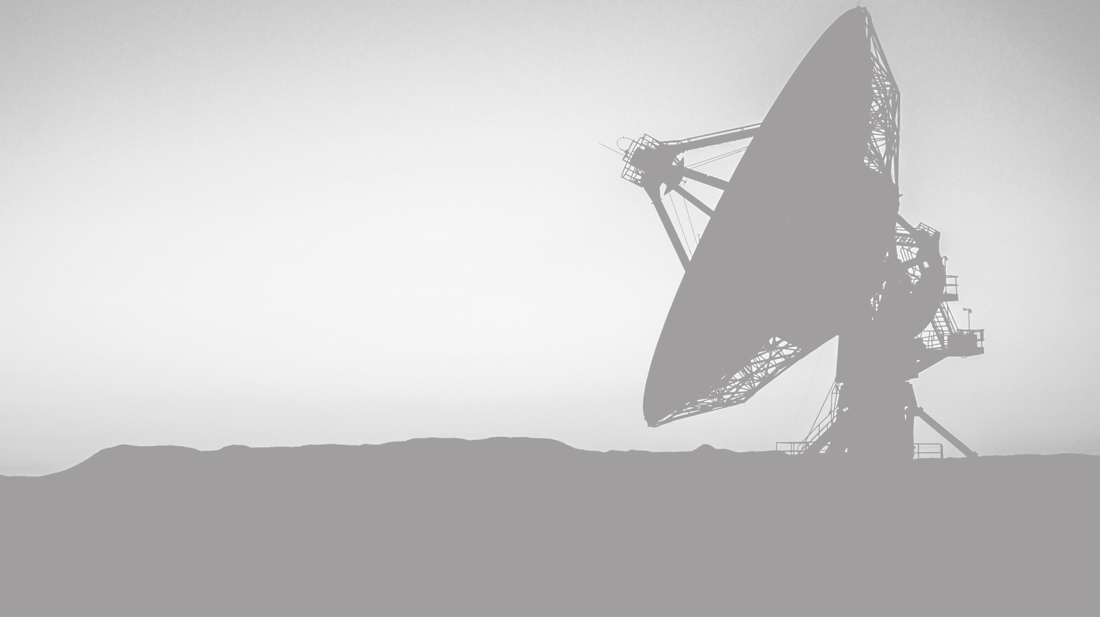
Satellite Communication with Electromagnetic waves
For a Sixth year audience.
By Reuben Allen & Jake Fortune.

Slide 2
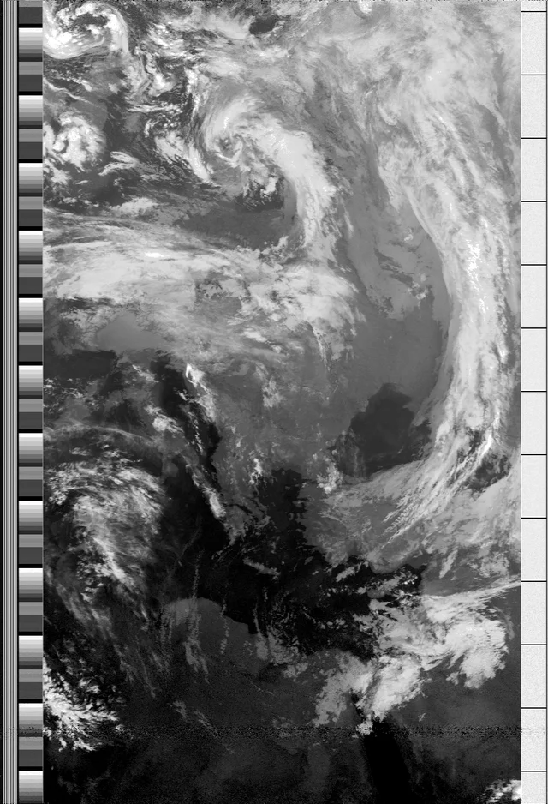
Broad overview of satellite communication.
The NOAA satellites receives data from its instruments.
The Data is transformed with amplitude modulation (A.M) and Automatic Picture transmission (APT).
Sending back data to receivers to earth using Electro-magnetic (E.M) waves.
E.M waves are received by an antenna and converted into a usable image.
Fig.1 APT image decoded showing Greece and Egypt

Slide 3
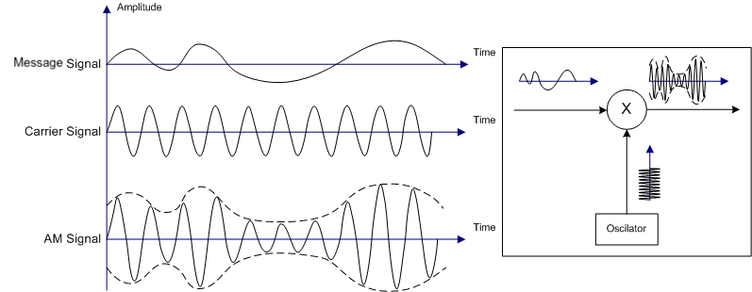
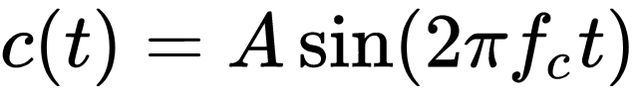
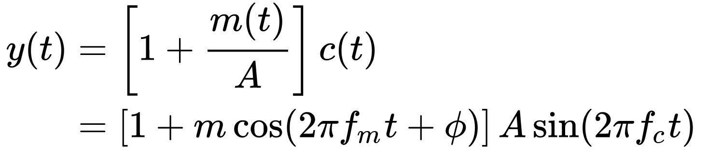
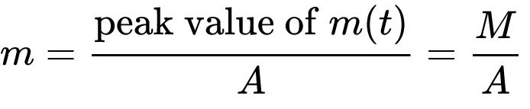
Receiving and modulating signal.
Carrier signal, shown in Equation 1 (Eq.1) is combined with the Message signal (Eq.2), to create a resultant wave (Eq.4)
The Resultant wave is now converted into a usable format, APT, to be sent from the satellite to earth.
fig. 2
Eq. 1
Eq. 3
Eq. 5
Eq. 4

Slide 4
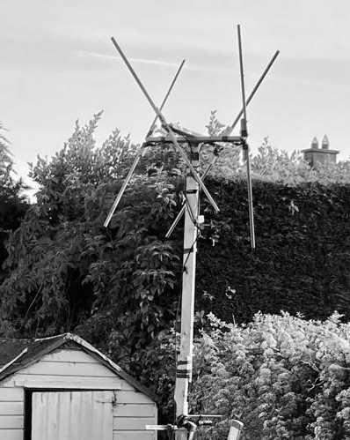
Receiving E.M waves with Antennas.
Antennas are designed to be resonant at a certain frequency
The length of the antenna is directly related to the wavelength
The length of the antenna should be equal to one half the wavelength of the radio waves it is designed to transmit
λ/2
Example: If the frequency of a radio wave is 137 MHz, the wavelength can be found by λ = c f
∴ λ = 3 x 10^8 / 137 x 10^6
∴ λ = 2.19m
This means you would need an antenna 1.095m long

Slide 5
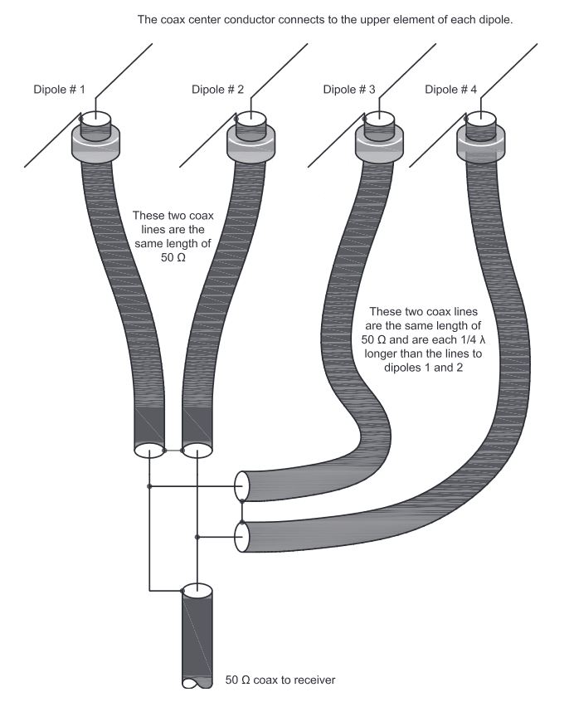
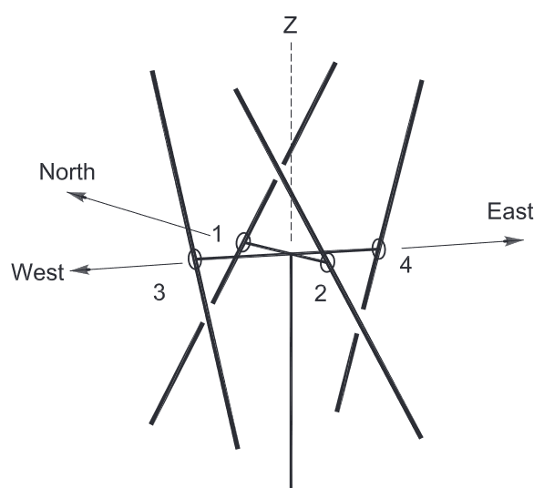
Antenna design.
Double-cross dipole antenna, Right hand circular polarization.
Fig. 3
Fig. 4

Slide 6
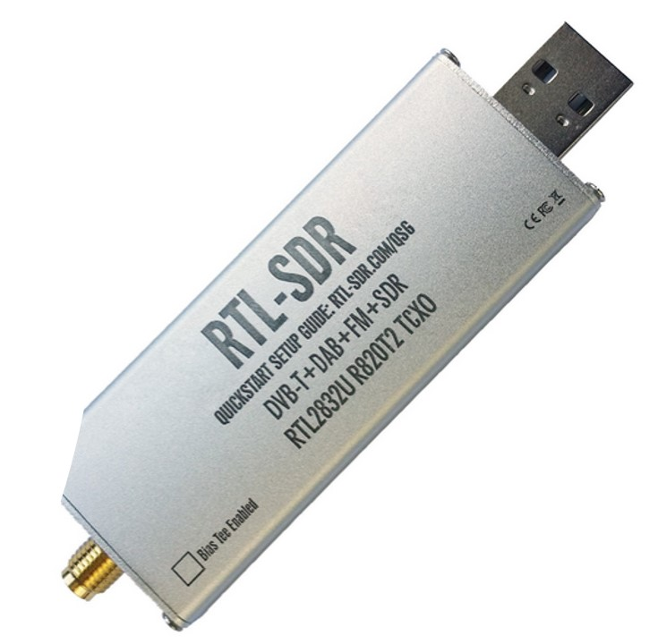
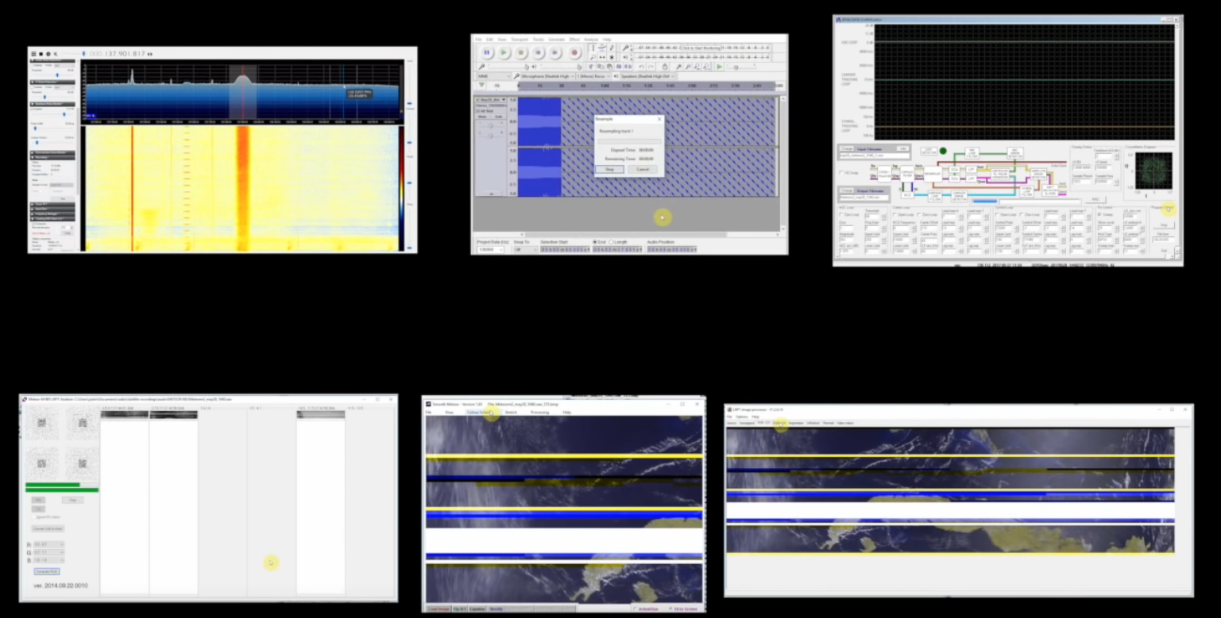
Software.
Convert from raw signal to usable image with SDR and available free software.
Fig. 6
Fig. 5

Slide 7
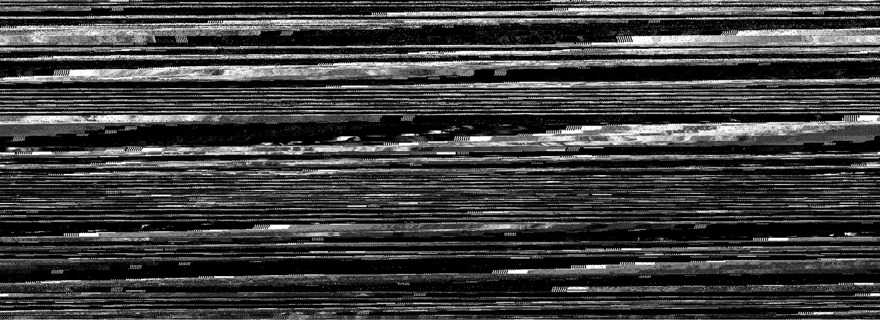
First pass.

Slide 8
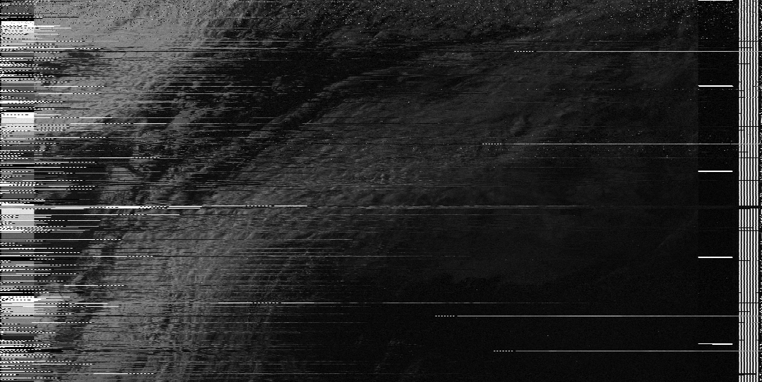
Second pass.

Slide 9
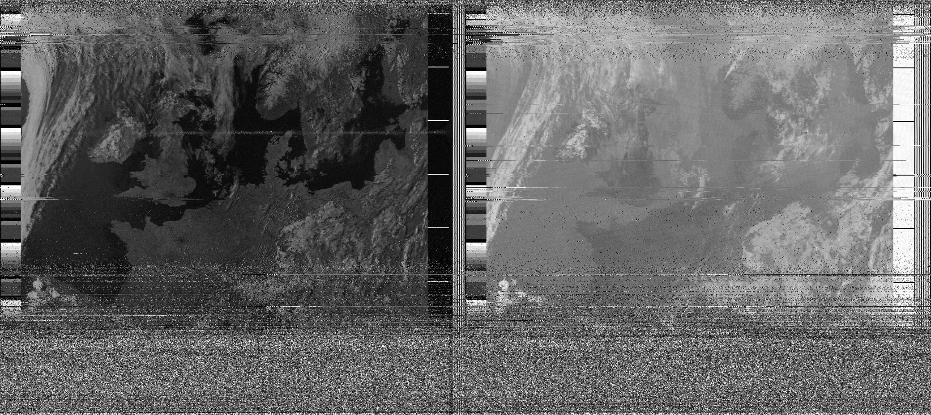
Final pass

Slide 10
Bibliography
Aftergood, Steven. “Introduction to Naval Weapons Engineering - Amplitude Modulation.” Man.fas.org, https://fas.org/, Jan. 1998, man.fas.org/dod-101/navy/docs/es310/AM.htm#Objectives.
Akira, Ivan. “English: The Illustration of Amplitude Modulation (AM) Which Depicts Comparison between Information Signal, Carrier Signal, and AM Signal.” Wikimedia Commons, 24 Mar. 2010, commons.wikimedia.org/wiki/File:Illustration_of_Amplitude_Modulation.png. Accessed 4 Apr. 2023.
Joseph Bevelacqu, Peter. “Antenna Basics.” Www.antenna-Theory.com, 2009, www.antenna-theory.com/basics/main.php. Accessed 4 Apr. 2023.
Kidwell, Kathy, and John Sapper. “NOAA KLM USER’S GUIDE with NOAA-N SUPPLEMENT.” NOAA.gov, NASA.gov, Apr. 2014, www1.ncdc.noaa.gov/pub/data/satellite/publications/podguides/N-15%20thru%20N-19/pdf/0.0%20NOAA%20KLM%20Users%20Guide.pdf. Accessed 4 Apr. 2023. Pages 4-54 to 4-57.
Martes, Gerald. “Double-Cross, NOAA Satellite Downlink Antenna.” Www.qsl.net, Feb. 2008, www.qsl.net/l/lu7did/docs/NOAA/DoubleCross_137Mhz%20AntennaMARTES.pdf.
Velasco, Cesar, and Christian Tipantuna. “Meteorological Picture Reception System Using Software Defined Radio (SDR).” 2017 IEEE Second Ecuador Technical Chapters Meeting (ETCM), Oct. 2017, https://doi.org/10.1109/etcm.2017.8247551..

